Slide 1
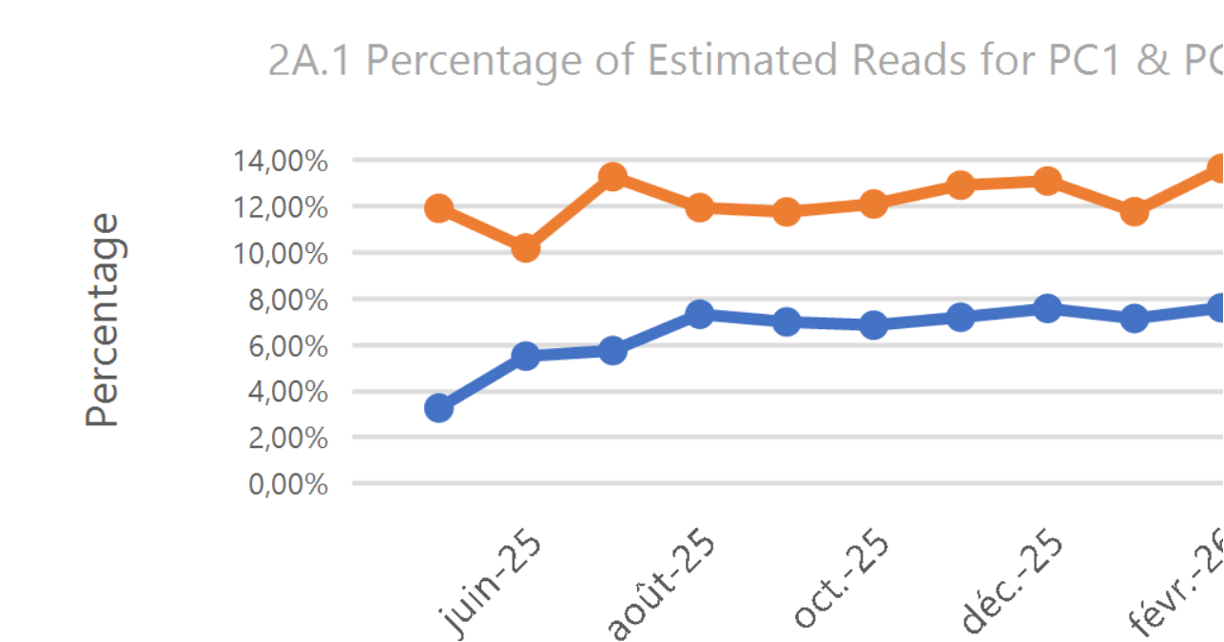
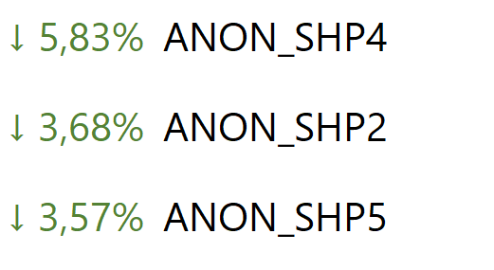
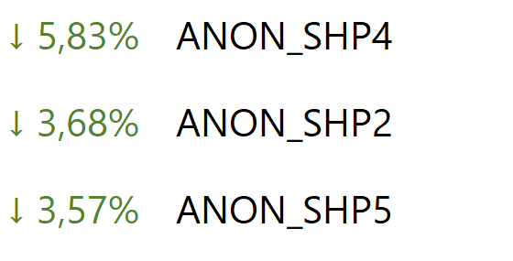
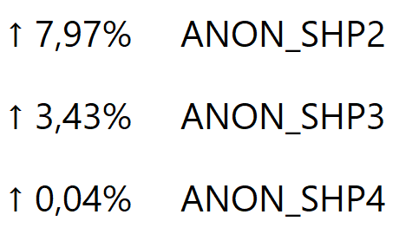
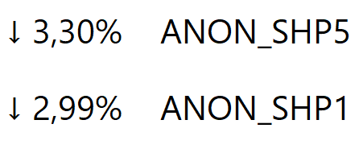
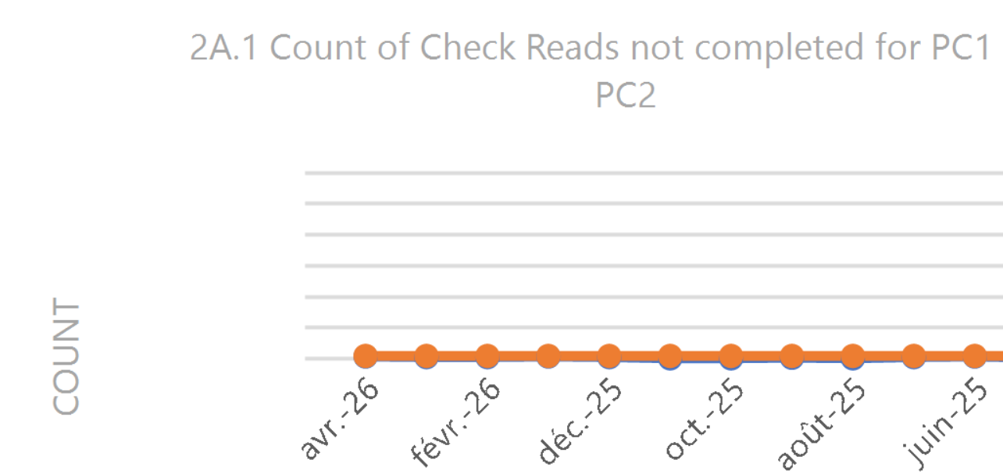
2A.1 ESTIMATED & CHECK READS- PRODUCT CLASSES 1&2
Report measures the average percentage across all Shippers portfolio in each market, where estimated reads were provided. Count of each Shippers portfolio where check reads were not provided
PC1
PC2
Industry movement
- Monthly change ↓ 1,12%
- Annual change ↓ 0,00%
Industry movement:
- Monthly change ↑ 1,03%
- Annual change ↓ 0,00%
Monthly changes
Monthly changes
Observations: -The number of uncompleted check reads in PC2 has shown a slight decrease from the previous month. -The percentage of estimated reads in both PC1 has shown a slight increase in February compared to the previous months, whilst PC2 has shown a decrease. Both will continue to be monitored..
2A.1 ESTIMATED & CHECK READS - PRODUCT CLASSES 1 & 2

